Slide 1

HabitFlow
Personal Habit Tracking Application
Web Engineering 2 — Full-Stack Project
GROUP MEMBERS
Abdul Waseh
Mueez Ahmad
Mir Fawad Ul Haq
May 2026

Slide 2

PRESENTATION OVERVIEW
Contents
01
Introduction
04
Database & API Design
Project overview and problem statement
MongoDB schema and REST API endpoints
02
Tech Stack & Architecture
05
Challenges & Conclusion
Technologies, tools, and system design
Development challenges, solutions, and future work
03
Core Features
Feature showcase with implementation details
02

Slide 3
01
CHAPTER ONE
Introduction
Project overview, team members, and problem statement

Slide 4
Introduction
Tech Stack
Core Features
Database & API
Conclusion
Project Overview
HabitFlow is a full-stack habit tracking app for building positive daily routines.
Tracks:
Namaz prayers with streak visualization
Work/focus sessions with built-in timer
Exercise with calorie tracking
Custom habits with completion logging
Todo tasks with priorities and due dates
KEY HIGHLIGHTS
MERN Stack — MongoDB, Express, React, Node.js
JWT Authentication with secure password hashing
Visual Analytics with Recharts and heatmap calendars
Gamification — XP, levels, badges, and streaks
TEAM MEMBERS
Abdul Waseh
Mir Fawad Ul Haq
Mueez Ahmad
Web Engineering 2 — Spring 2026
04

Slide 5
Introduction
Tech Stack
Core Features
Database & API
Conclusion
Problem Statement
Students and professionals struggle to maintain consistency in daily habits. Existing solutions have significant gaps that HabitFlow addresses.
Too Complex
Not Culturally Inclusive
No Integrated Analytics
Existing apps are overloaded with features, making habit tracking feel like a chore rather than a helper.
Most habit trackers lack support for prayer tracking and culturally relevant habit categories.
Users cannot visualize progress trends or get meaningful insights about their habit consistency.
Our Solution: HabitFlow provides a simple, unified platform with integrated analytics, gamification, and culturally-aware habit tracking — all in one responsive web application.
05

Slide 6
02
CHAPTER TWO
Tech Stack & Architecture
Technologies, tools, and system architecture

Slide 7
Introduction
Tech Stack
Core Features
Database & API
Conclusion
Technology Stack
Frontend
Backend
Database & Tools
React 19 — UI framework
Vite — Build tool
TailwindCSS v4 — Styling
Recharts — Data visualization
Framer Motion — Animations
Axios — HTTP client
Node.js — Runtime
Express.js — Web framework
JWT — Authentication
bcryptjs — Password hashing
Helmet — Security headers
CORS — Cross-origin requests
MongoDB — NoSQL database
Mongoose — ODM library
MongoDB Atlas — Cloud hosting
Render — Deployment
Git — Version control
npm — Package manager
Additional Libraries
React Router DOM
React Hot Toast
date-fns
canvas-confetti
express-validator
dotenv
07

Slide 8
Introduction
Tech Stack
Core Features
Database & API
Conclusion
System Architecture
React Client
Request Flow
SPA with React Router, Axios requests
1
User Action — User interacts with the React frontend (clicks, form submits, timer start/stop)
2
API Request — Axios sends HTTP request with JWT Bearer token to Express server
Express API Server
RESTful routes, JWT middleware, controllers
3
Authentication — JWT middleware validates token, extracts userId from payload
4
Business Logic — Controller processes request, interacts with Mongoose models
MongoDB Atlas
JSON Response — Server returns structured JSON data, React updates UI state
5
Cloud-hosted NoSQL database via Mongoose
08

Slide 9
03
CHAPTER THREE
Core Features
Feature showcase with implementation details

Slide 10
Introduction
Tech Stack
Core Features
Database & API
Conclusion
Dashboard & Namaz Tracker
DASHBOARD
NAMAZ TRACKER
Visual Overview Hub
Prayer Tracking System
The dashboard provides an at-a-glance view of all tracked habits:
Daily streak counters per habit category
Current XP level and progress bar
Quick stats cards with key metrics
Recent activity feed with timestamps
Quick navigation to all modules
Track all five daily prayers with visual streak representation:
Fajr, Zuhr, Asr, Maghrib, Isha — individual toggle
Visual streak calendar with heatmap coloring
Monthly prayer completion statistics
Consecutive day streak tracking
10 XP awarded per prayer logged
Streak Tracking
Heatmap Calendar
XP Rewards
Monthly Stats
Smart Algorithm
Color-Coded Days
10 XP / Prayer
Recharts Analytics
10

Slide 11
Introduction
Tech Stack
Core Features
Database & API
Conclusion
Work Timer & Exercise Logger
WORK TIMER
EXERCISE LOGGER
Focus Session Timer
Activity Tracking
Built-in Pomodoro-style timer for deep work sessions:
Start/stop timer with single click
Automatic duration calculation in seconds
Link sessions to specific todo tasks
XP rewards: 5 XP per minute of focus time
Monthly work stats with streak tracking
Personal best session duration recorded
Log and track physical activities with smart features:
Support for running, walking, cycling, gym
Auto-calculated calories based on activity type
Distance and duration tracking per session
Current streak with smart gap detection
Monthly stats: total duration, calories, best
Activity type breakdown and filtering
Activity Type | Calorie Rate | XP Reward | Tracked Metrics
Running | 10 cal/min | Duration x 2 | Distance, Duration, Calories
Walking / Cycling / Gym | 5-8 cal/min | Duration x 2 | Distance, Duration, Calories
11

Slide 12
Introduction
Tech Stack
Core Features
Database & API
Conclusion
Todo Manager & Custom Habits
TODO MANAGER
CUSTOM HABITS
Task Management System
Personal Habit Builder
Full-featured todo system for productivity:
Create custom lists with color coding
Add tasks with priority and due dates
Track estimated vs actual time spent
Link tasks to work timer sessions
Status: pending, in-progress, completed
15 XP reward for each completed task
Create and track any personal habit:
Custom habit name, description, category
Daily completion toggle with one click
Current streak and personal best tracking
Smart streak calculation with gap handling
Color-coded habit cards on dashboard
20 XP reward for each habit completion
Task Lifecycle Flow
Create Task
In Progress
Completed
Earn XP +15
12

Slide 13
Introduction
Tech Stack
Core Features
Database & API
Conclusion
Analytics & Gamification
ANALYTICS ENGINE
GAMIFICATION
Visual Data Insights
XP, Levels & Badges
Comprehensive analytics powered by Recharts:
Prayer Trends — Daily prayer count bar charts
Work Hours — Weekly focus time line graphs
Exercise Stats — Activity duration comparisons
Task Heatmap — Calendar view of completions
Monthly Averages — Aggregated performance metrics
Date Filtering — View any month or year
Motivation system to build consistency:
XP System — Earn XP for every habit action
Level Progression — 100 x level^2 XP to level up
Badge Awards — Milestone achievements
Streak Tracking — Consecutive day counters
XP History — Complete audit log of earnings
Category Breakdown — XP by habit type
Level 5 Pioneer
Habit Master
Faithful Week
Iron Focus
Task Smasher
Centurion
Reached Level 5
Reached Level 10
7 days of prayers
10 hours deep work
10 tasks completed
Reached Level 25
13

Slide 14
04
CHAPTER FOUR
Database & API Design
MongoDB schema design and REST API endpoints

Slide 15
Introduction
Tech Stack
Core Features
Database & API
Conclusion
Database Schema Design
Collection | Purpose | Key Fields | Relationships
Users | Authentication & Profile | name, email, password, dob, level, xp | Parent of all user data
NamazLogs | Daily prayer records | userId, date, fajr, zuhr, asr, maghrib, isha | Belongs to User
WorkSessions | Focus timer sessions | userId, startTime, endTime, duration, taskId | Belongs to User, links to Task
ExerciseLogs | Activity tracking | userId, activityType, distance, duration, calories | Belongs to User
TodoLists | Task list groups | userId, name, color | Parent of TodoTasks
TodoTasks | Individual tasks | listId, title, priority, status, dueDate, actualTime | Belongs to TodoList
CustomHabits | User-defined habits | userId, name, description, category, color | Parent of HabitLogs
HabitLogs | Daily habit completions | habitId, userId, date, completed | Belongs to CustomHabit
Badges & XpHistory | Gamification data | userId, name, earnedAt / amount, source, date | Belongs to User
Design Pattern: All collections use UUID string-based _id fields via Mongoose. UserId references link every document to its owner, enabling secure multi-user data isolation. MongoDB's flexible schema allows easy future extensions.
15

Slide 16
Introduction
Tech Stack
Core Features
Database & API
Conclusion
REST API Endpoints
Route | Method | Endpoint | Description
Auth | POST | /api/auth/register | User registration with validation
<p><span></span></p> | POST | /api/auth/login | Login, returns JWT token
<p><span></span></p> | GET | /api/auth/me | Get current user profile
Namaz | GET/POST | /api/namaz/today, /log | Fetch and log daily prayers
Work | POST | /api/work/start, /stop | Start and stop focus timer
Exercise | POST/GET | /api/exercise/log, /logs | Log and fetch exercise data
Habits | CRUD | /api/habits, /habits/:id | Create, read, update, delete
Todo | CRUD | /api/todo/lists, /tasks | List and task management
Analytics | GET | /api/analytics/overview | Dashboard analytics data
Users | PUT/DELETE | /api/users/profile, /account | Profile and account management
Security: All routes except /auth/register and /auth/login are protected by JWT middleware. Requests must include Authorization: Bearer <token> header. Invalid or expired tokens return 401 Unauthorized.
16

Slide 17
05
CHAPTER FIVE
Challenges & Conclusion
Development challenges, solutions, and future work

Slide 18
Introduction
Tech Stack
Core Features
Database & API
Conclusion
Challenges & Solutions
1
Streak Calculation
2
MongoDB Aggregation
3
Timer State Management
Challenge: Calculating accurate streaks across date gaps and multiple entries per day.
Challenge: Complex analytics queries requiring multi-collection aggregation with date filtering.
Challenge: Maintaining accurate timer state across page navigations and browser refreshes.
Solution: Smart algorithm that checks today/yesterday continuity first, then iterates backwards detecting gaps greater than 1 day.
Solution: Optimized Mongoose queries with date-range filtering, lean() for performance, and in-memory aggregation for complex calculations.
Solution: React Context API with localStorage persistence, storing startTime timestamp and calculating elapsed time on component mount.
Key Learnings
Full-stack development requires careful API design. MongoDB's flexibility speeds up prototyping. JWT auth patterns are essential for secure SPAs. React Context + localStorage solves many state persistence challenges.
18

Slide 19
Introduction
Tech Stack
Core Features
Database & API
Conclusion
Future Enhancements
Mobile App
Social Features
AI Recommendations
Build a React Native mobile app for iOS and Android with offline support and push notifications.
Friend challenges, leaderboards, and habit sharing to build a community of motivated users.
AI-powered habit suggestions based on user patterns, missed streaks, and optimal timing.
Push Notifications
Dark Mode Theme
Multi-Language
Reminders for prayer times, habit deadlines, and streak maintenance via push notifications.
Full dark mode support for comfortable usage during night hours and reduced eye strain.
Support for Urdu, Arabic, and other languages to make the app accessible globally.
19

Slide 20
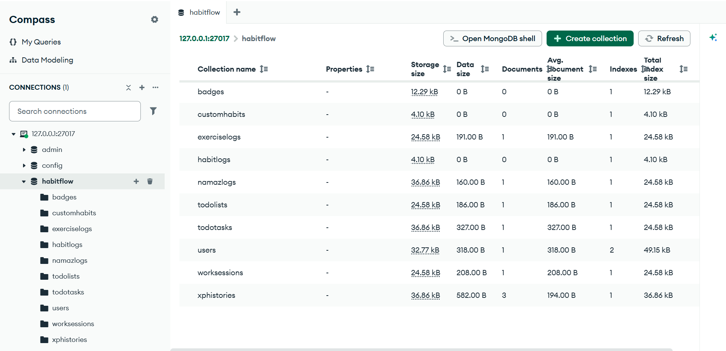

Slide 21
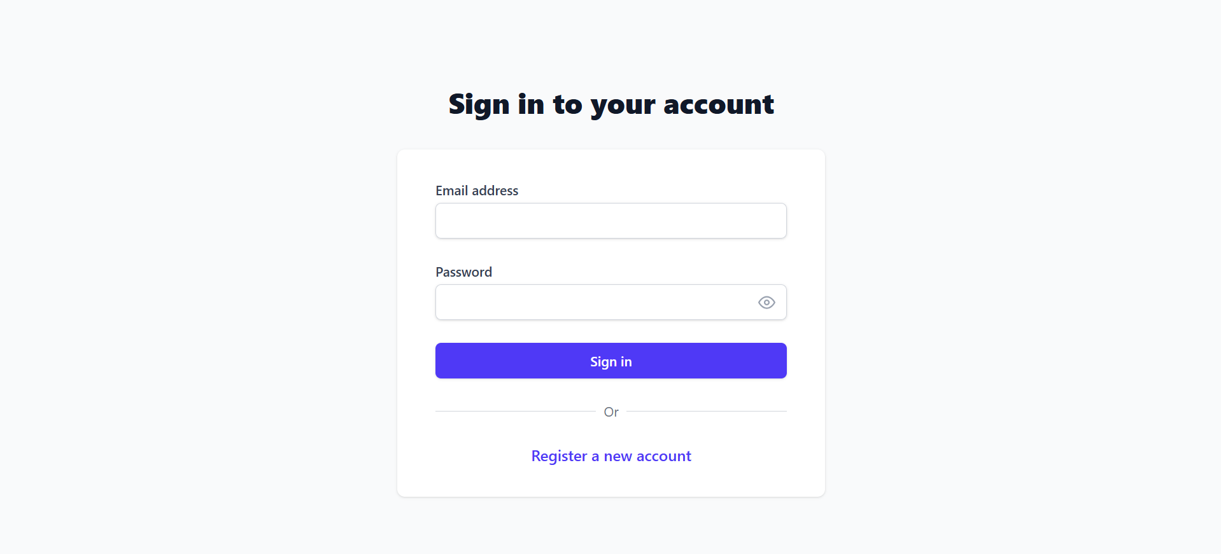

Slide 22
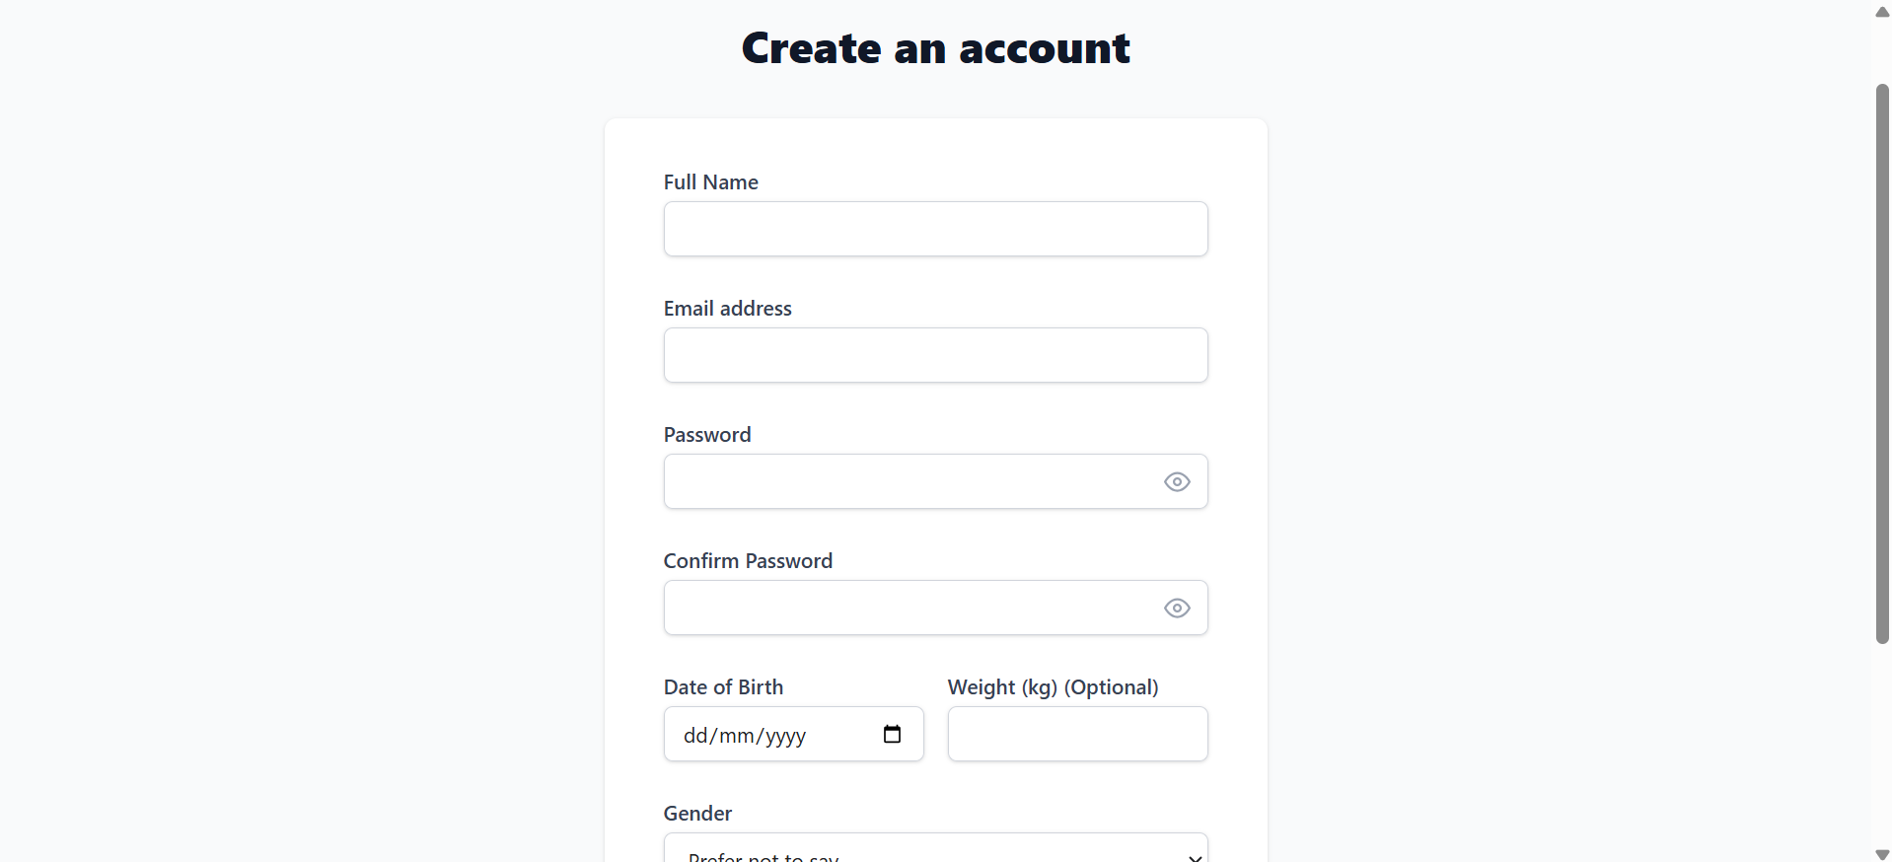

Slide 23
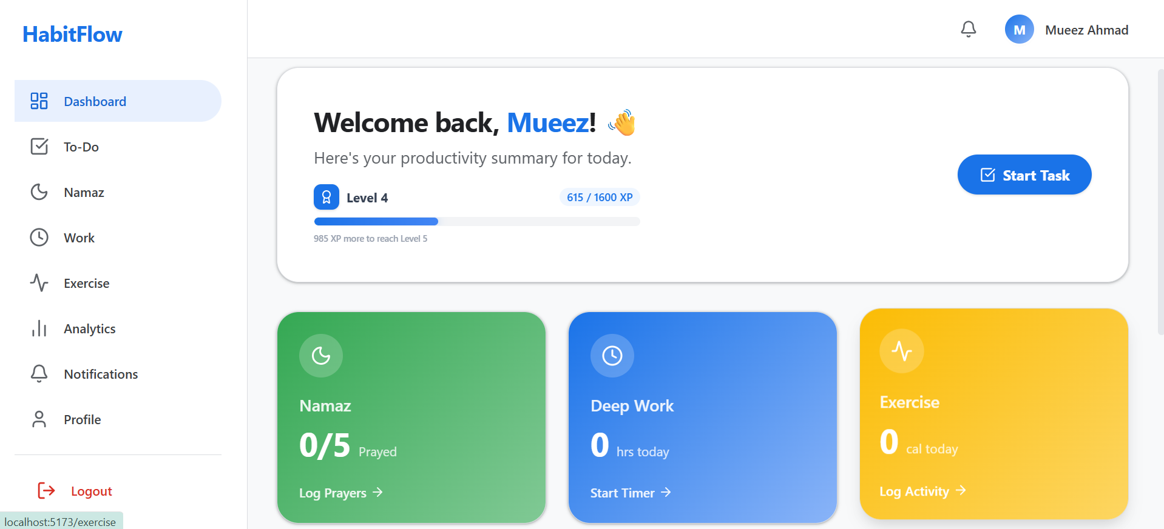

Slide 24
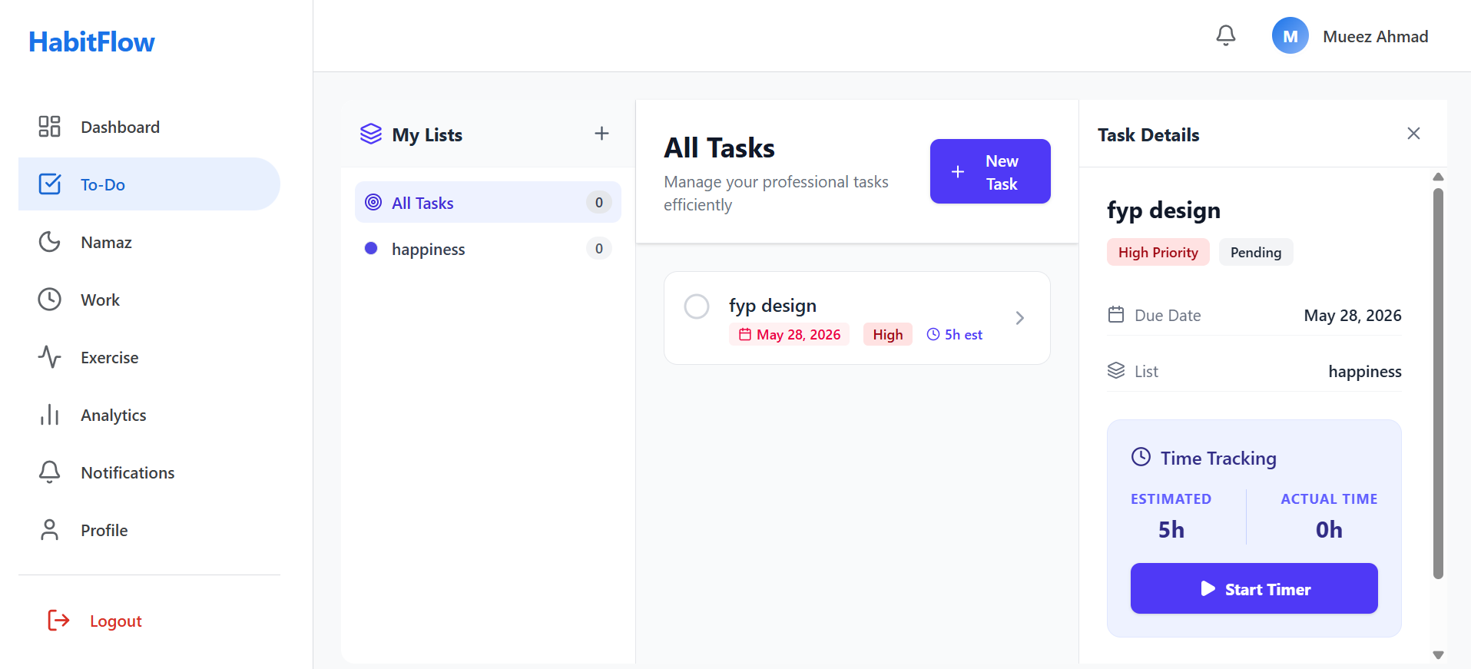

Slide 25
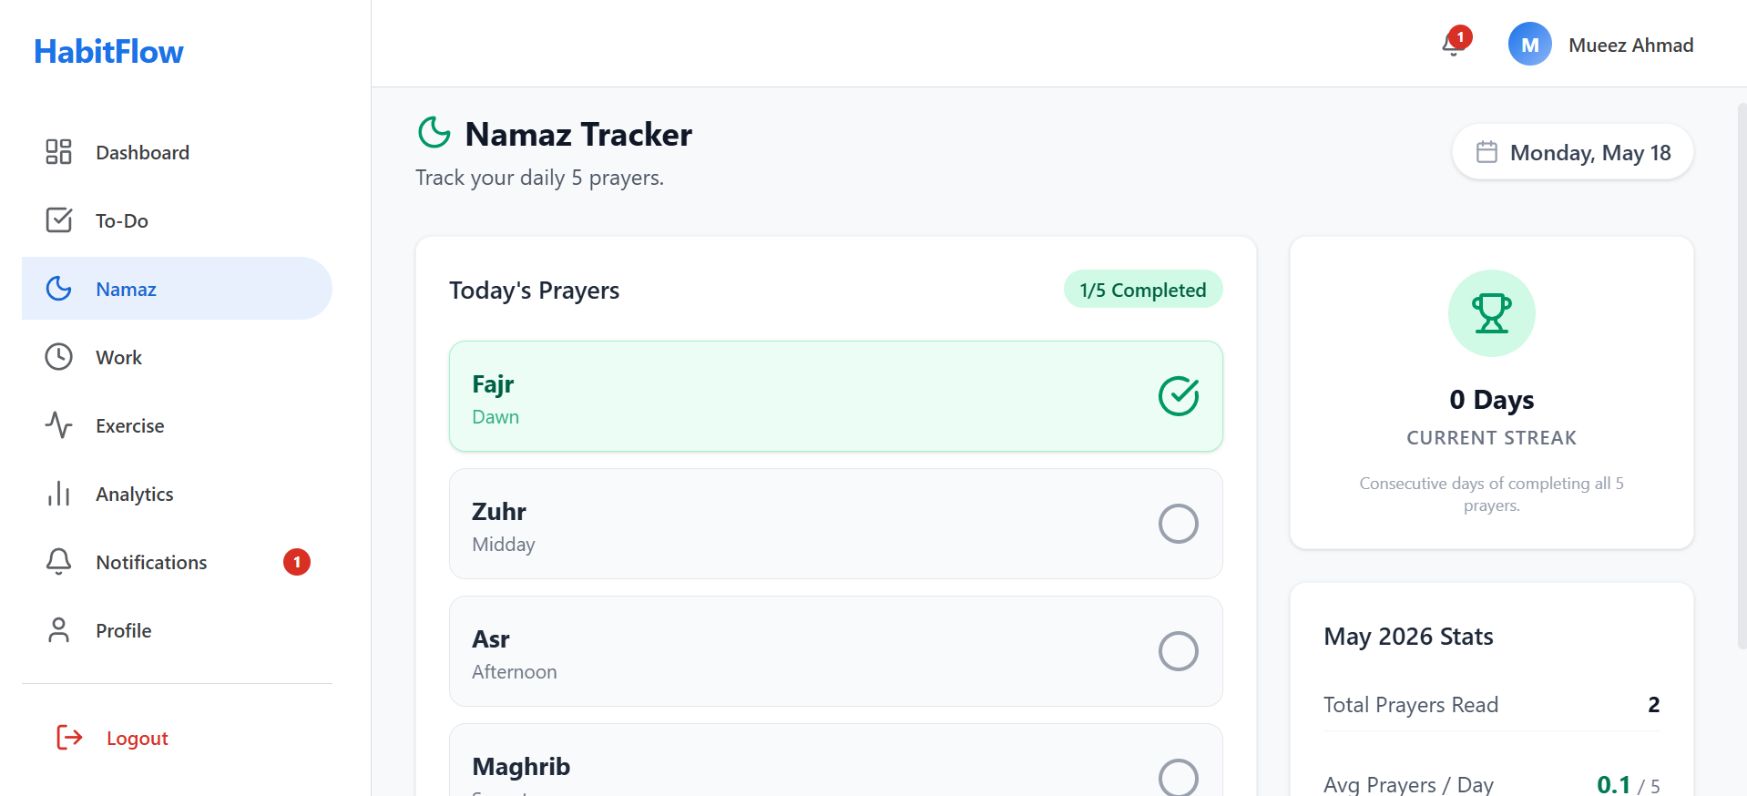

Slide 26
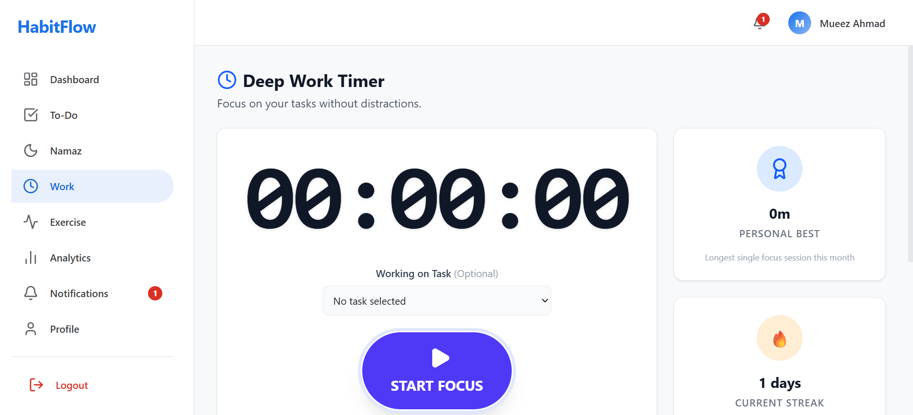

Slide 27
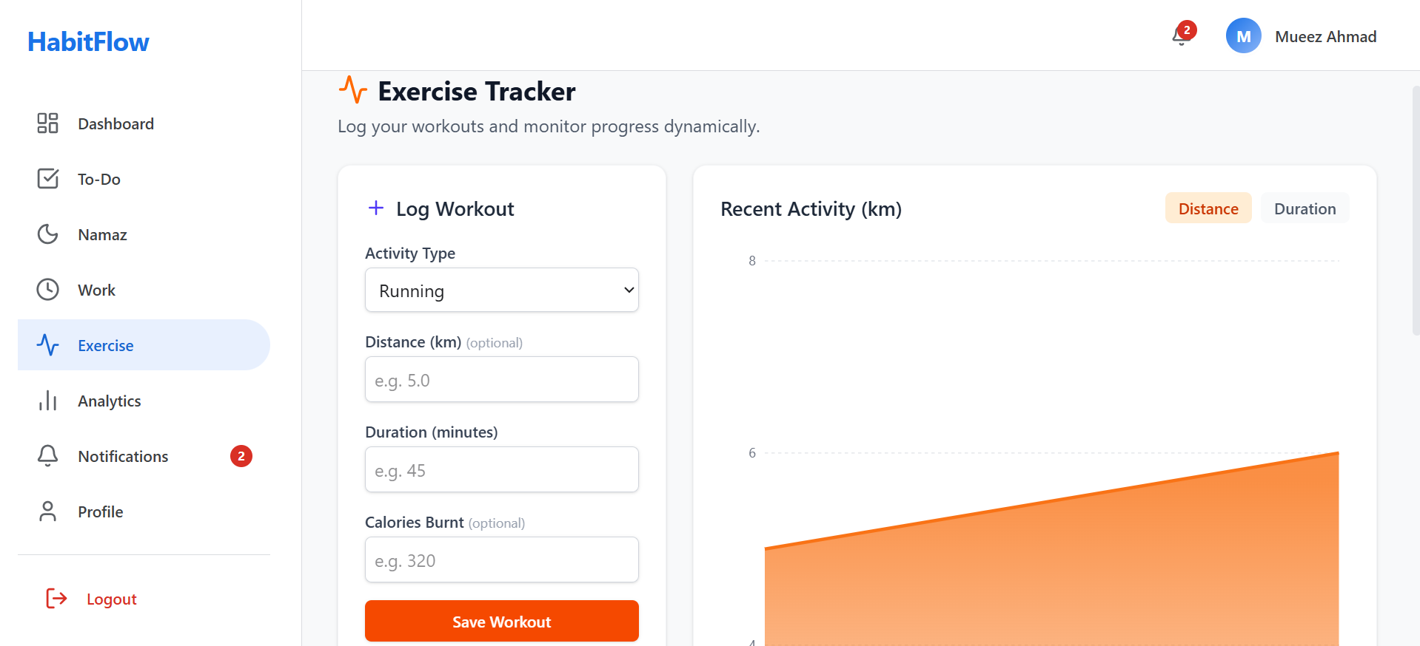

Slide 28
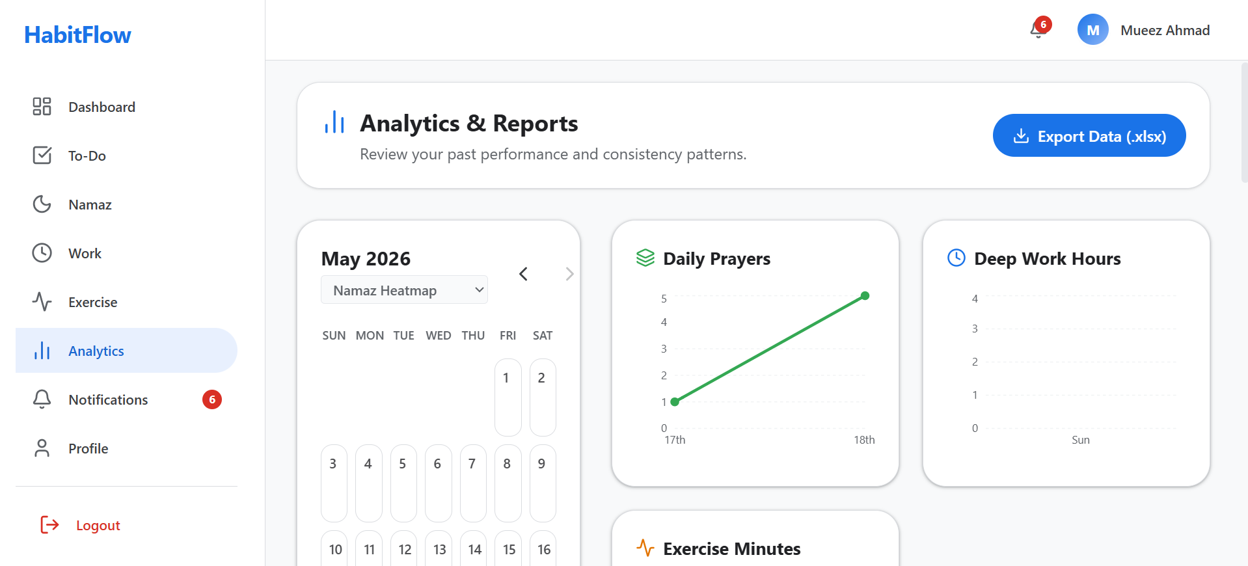

Slide 29
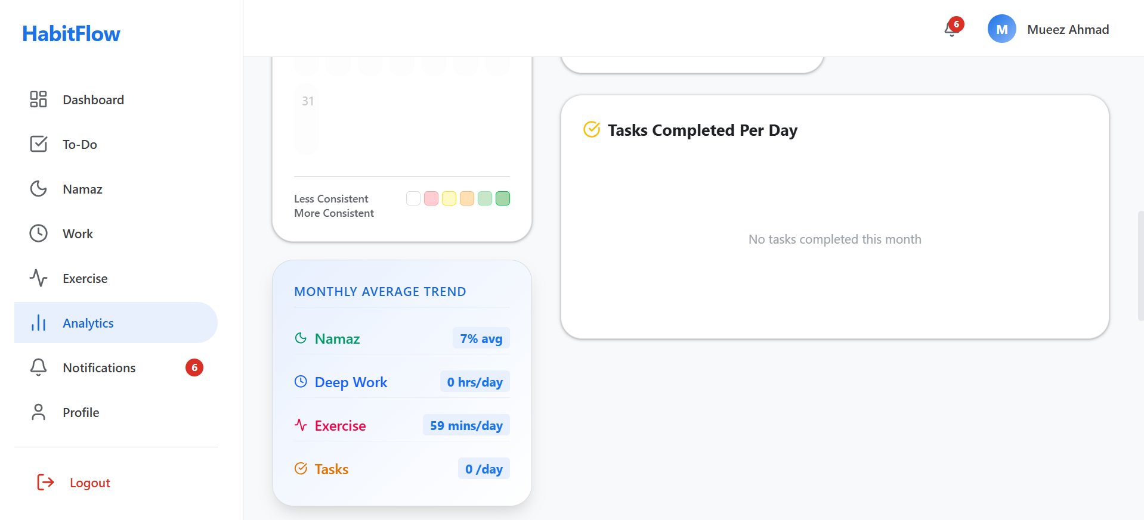

Slide 30
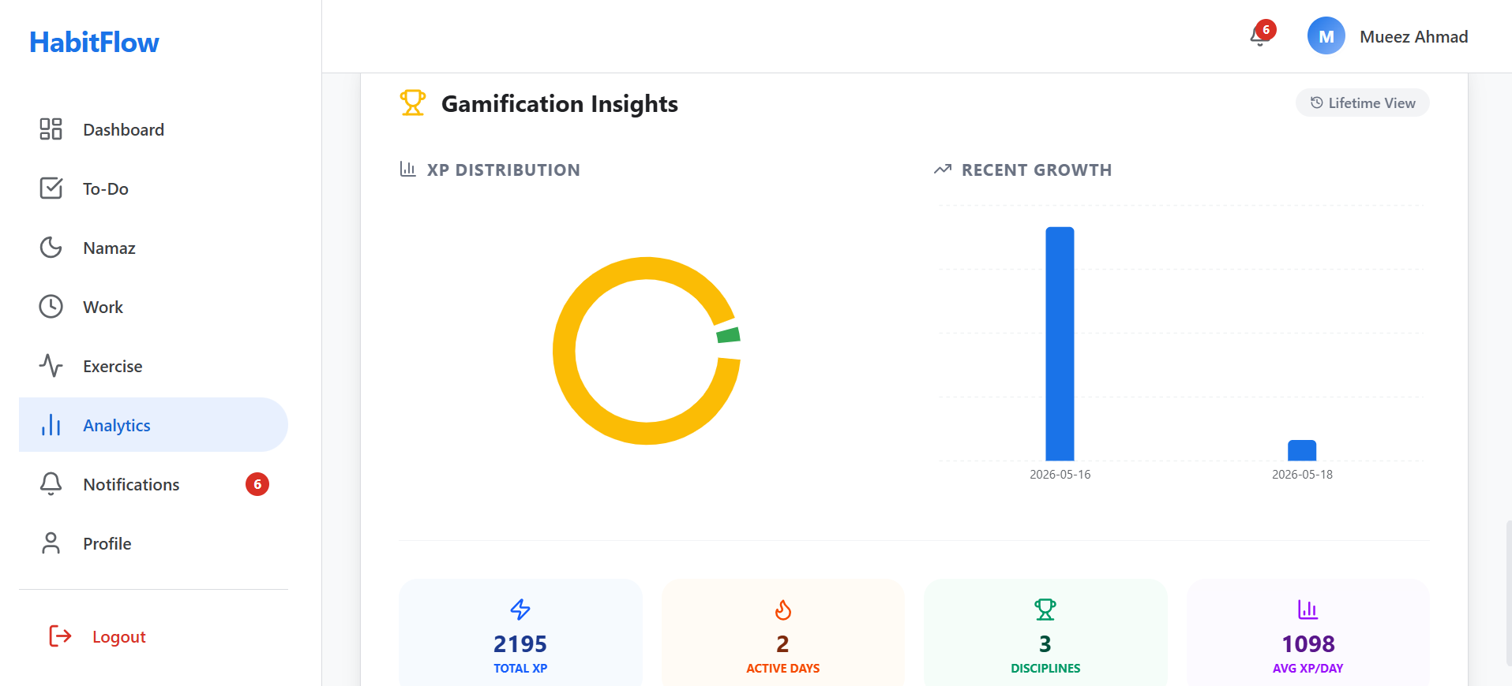

Slide 31


Slide 32
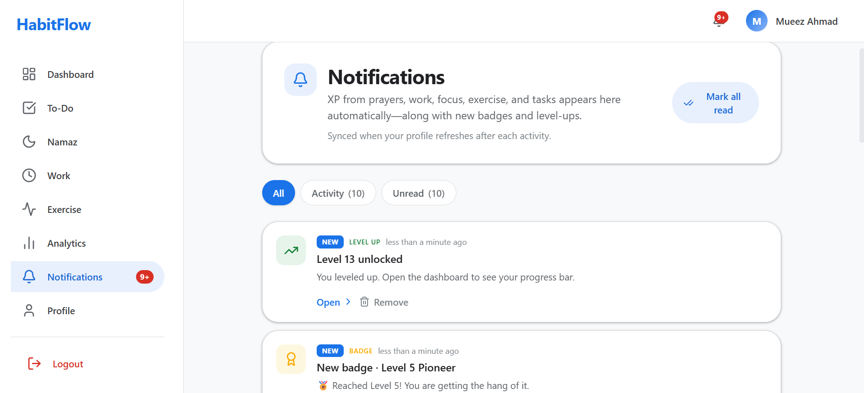

Slide 33
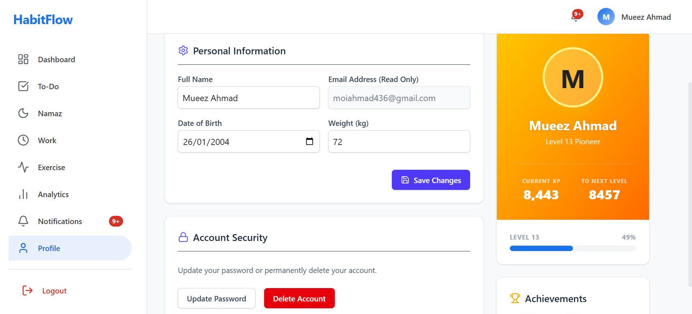

Slide 34
Thank You
Building Better Habits, One Day at a Time
Questions & Answers Welcome
PRESENTED BY
Abdul Waseh
Mueez Ahmad
Mir Fawad Ul Haq
Web Engineering 2 — Spring 2026

